Slide 1
Web Programming
Node - Cookies - Error Handling
Lecture 27
Mahhek Khan
Notes:
.

Slide 2
What are cookies?
Cookies are small text files stored on the client’s browser.
Used to remember information between HTTP requests (which are stateless).
Commonly used for authentication, user preferences, tracking, and analytics.
Each cookie has a name-value pair, and optional attributes (e.g., expiry, path, secure).
npm install cookie-parser

Slide 3
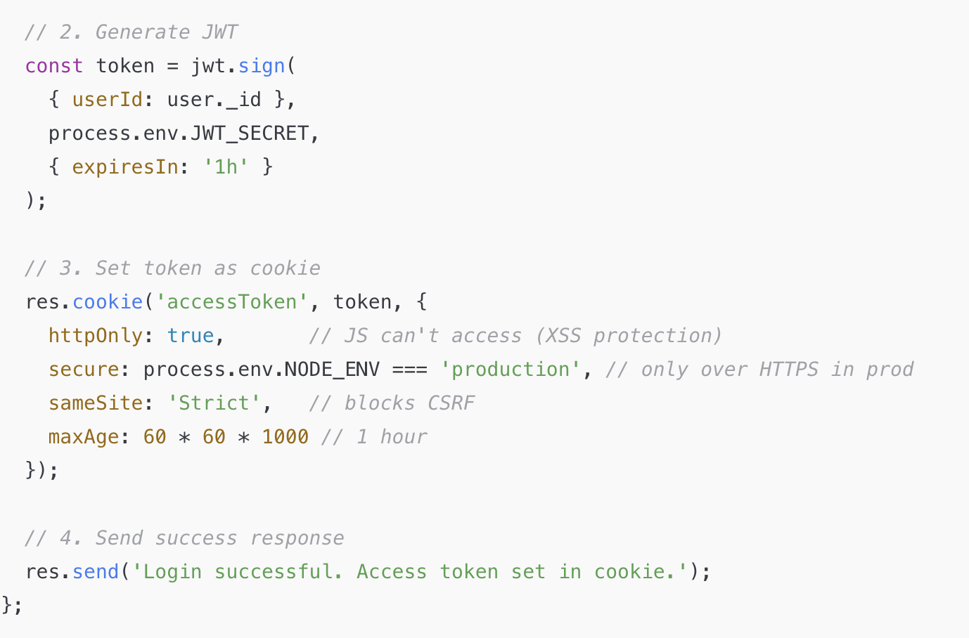
Set Cookie - Server Side

Slide 4
Set Cookie - Client Side
The browser stores the cookie in its internal cookie store.
On every future request to the same domain, it automatically adds:
Cookie: accessToken=eyJhbGciOiJIUzI1..
When you use the res.cookie() method in your server code, the cookie is set in the browser's internal cookie store automatically.

Slide 5
in index.js
const express = require('express');
const cookieParser = require('cookie-parser');
const app = express();
// Middleware to parse cookies
app.use(cookieParser());
console.log(req.cookies.accessToken);
app.listen(5000, () => {
console.log('Server is running on http://localhost:3000');
});

Slide 6
Access Cookie
console.log(req.cookies.accessToken);
This line means:
Print the value of the cookie named accessToken from the incoming request (req) to the console.
Breakdown:
req.cookies is an object containing all cookies sent by the user's browser.
req.cookies.accessToken accesses the specific cookie named "accessToken".

Slide 7
Access Cookie
Cookie: userId=abc123; theme=dark
req.cookies = {
userId: 'abc123',
theme: 'dark'
}
So req.cookies.userId would be 'abc123'.

Slide 8
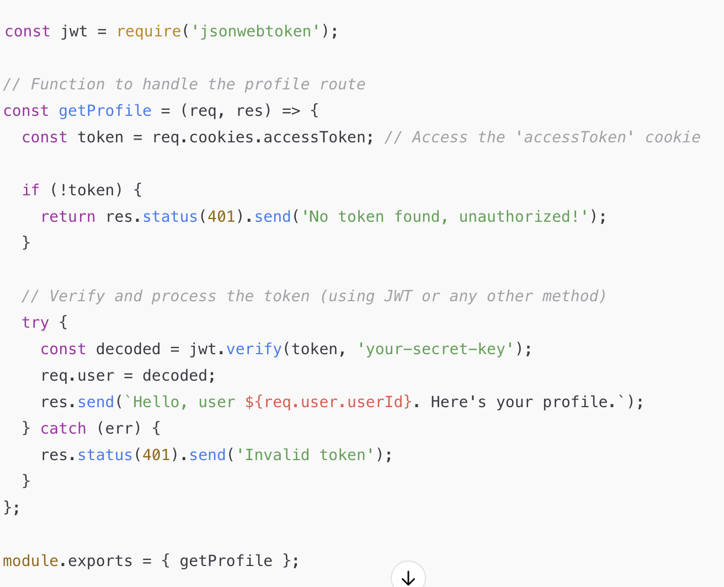
Access Cookie

Slide 9
Secure and HttpOnly Cookies
HttpOnly: Prevents JavaScript access via document.cookie, helping avoid XSS attacks.
Secure: Only sent over HTTPS.
SameSite: Mitigates CSRF by controlling cross-site request behavior.
Set like this:
res.cookie('token', 'abc123', { httpOnly: true, secure: true, sameSite: 'Strict' });

Slide 10
Error handling middleware
Middleware Error Handling in Express (without try-catch)
Use Async Error Handling Middleware
Express doesn’t catch errors thrown in async route handlers by default.

Slide 11
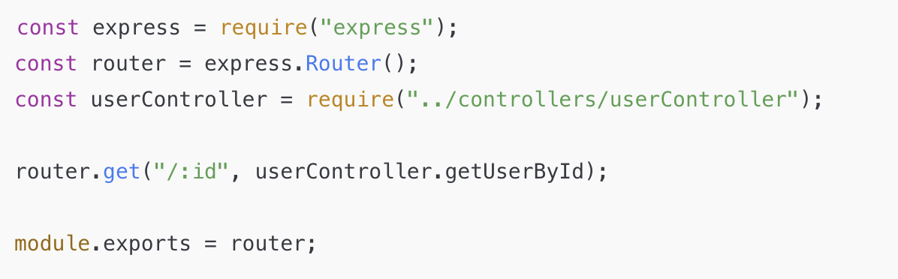
Without Error handling
Route.js
Problem: try-catch is inside every controller, cluttering logic and repeating error handling.

Slide 12
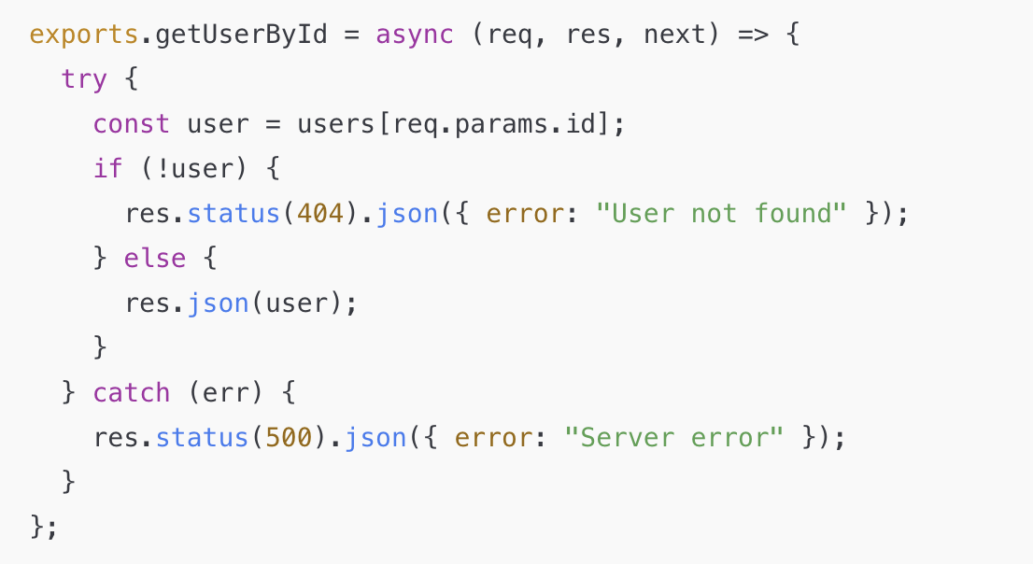
Without Error handling - Controller

Slide 13
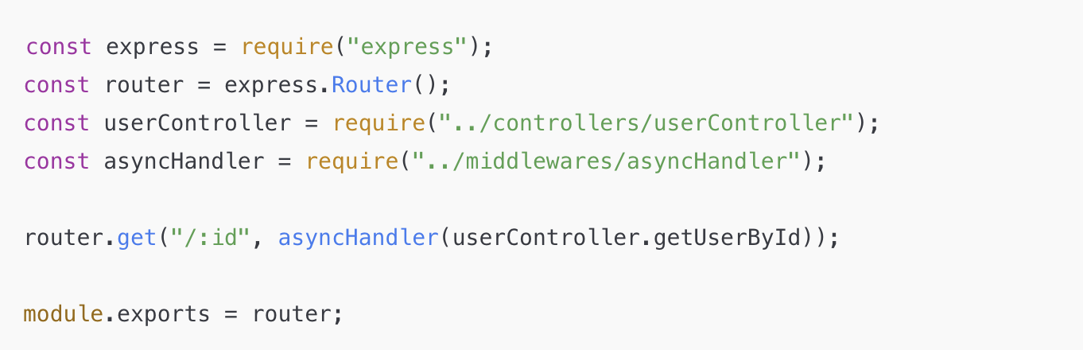
With AyncHandler + ErrorHandler
Route.js

Slide 14
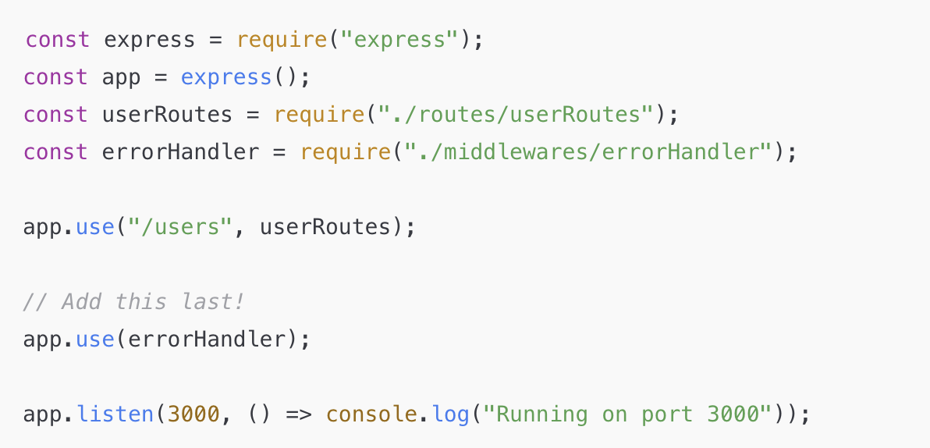
With AyncHandler + ErrorHandler
index.js

Slide 15
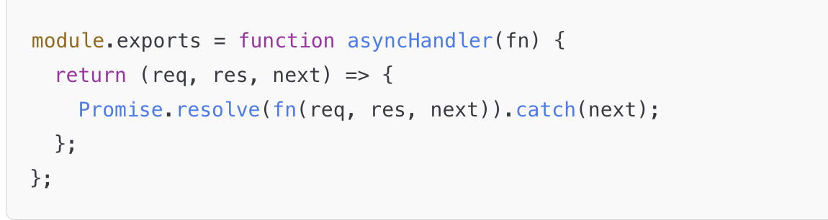
With AyncHandler + ErrorHandler
asyncHandler.js
Promise.resolve(fn(req, res, next)).catch(next);
is the key magic that sends any error to your errorHandler.js.

Slide 16
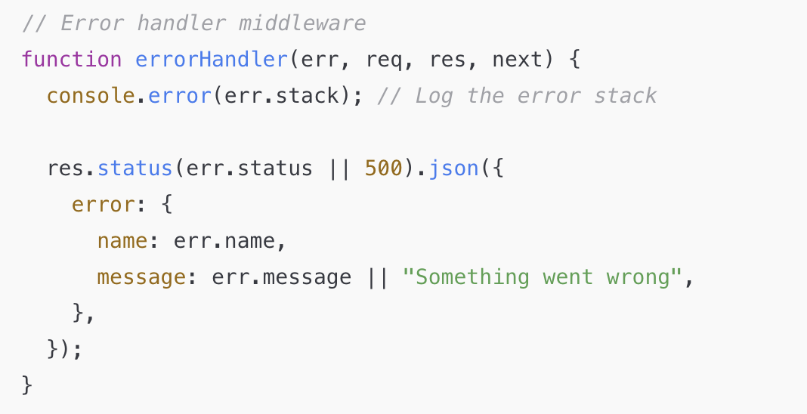
With AyncHandler + ErrorHandler
errorHandler.js

Slide 17
How it works?
fn(req, res, next) runs your async controller (like getUserById).
If that function throws an error (or await fails), it becomes a rejected promise.
.catch(next) catches the error and passes it to next(err).
In Express, calling next(err) automatically sends the error to the last error-handling middleware, which is your:
app.use(errorHandler);

Slide 18
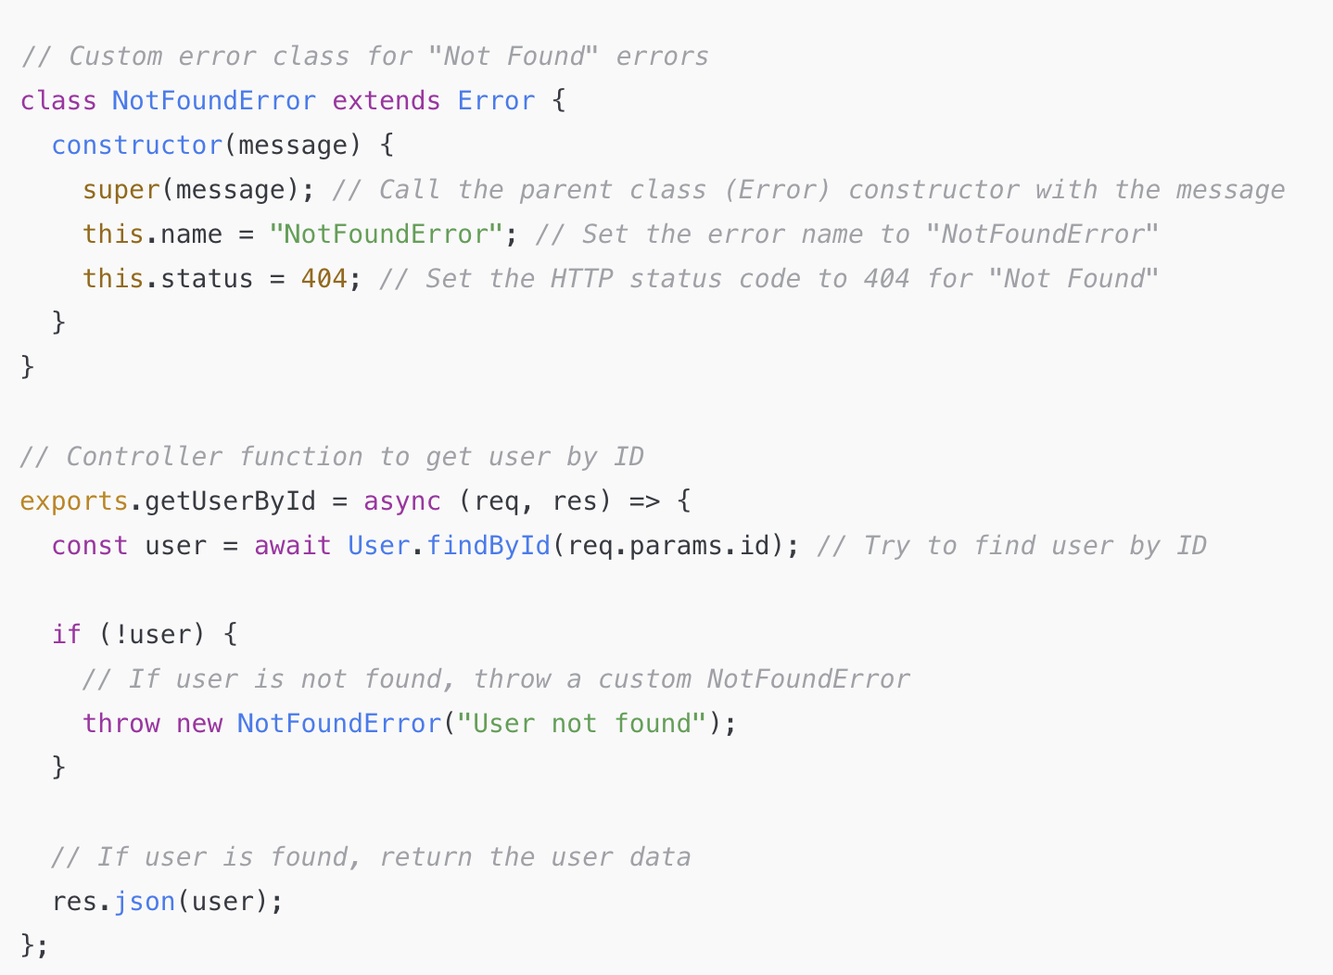
userController.js

Slide 19
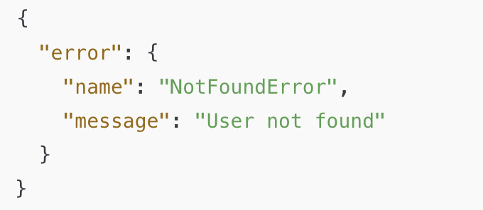
Response from User not found - Custom error

Slide 20
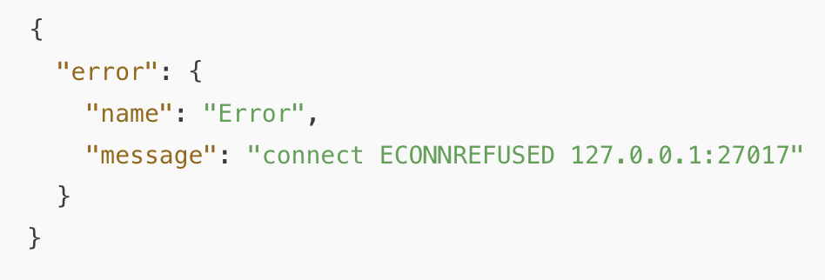
Response from Database Failure - Inbuilt error

Slide 21


